Slide 1

Starch Adhesives
Effective Usage & Optimal Solutions
Amylodex Pvt.Ltd 19 Mar 2016 at RCBMA Jodhpur Bhaskar BV Reddy

Slide 2

Objective
To discuss Starch Adhesive parameters , its effective usage & optimal solutions for Manual Plant
Amylodex Pvt.Ltd 19 Mar 2016 at RCBMA Jodhpur Bhaskar BV Reddy

Slide 3
Topics
Starch Adhesive Parameters
Effective Usage of Starch Adhesives
How to dry ( 9-10% moisture) Box in one hour
Case Study - Moisture profile in Hand pasted Machine
Case Study - Moisture Profile in Flute laminator pasted Board
Optimal Adhesive Solutions for Manual Plant
Amylodex Pvt.Ltd 19 Mar 2016 at RCBMA Jodhpur Bhaskar BV Reddy

Slide 4
Starch Adhesive Parameters
Parameters affecting the board quality
  Viscosity
  Solids
  Starch Base ( Tapioca /Maize)
  Additives / Preservatives
Parameters affecting Ease of Use
  Liquid Adhesives / Powder Adhesives
  Hot Process Neutral pH adhesives
  Cold Process high pH alkaline adhesives
  Cold Process Neutral pH adhesive
Amylodex Pvt.Ltd 19 Mar 2016 at RCBMA Jodhpur Bhaskar BV Reddy
Notes:
Starch Adhesive parameters affecting the Board quality.
Viscosity
Solids
Starch base ( Tapioca , Maize, Rice etc)
Additives
Preservative
Starch Adhesive Properties affecting ease of using
Powder Adhesives
Liquid Adhesives
Hot process Neutral pH adhesives
Cold process Alkaline high pH adhesives
Cold process Neutral Adhesives

Slide 5
Effective Usage of Adhesives
Define specification.
Inspection of adhesive consignment before accepting
Preparation - Equipment, Water intake & glue mixing
Quality checks -
  Viscosity
  Solids
Application of glue
Inspection of Bonding & drying time.
Instruments & QC readings
Amylodex Pvt.Ltd 19 Mar 2016 at RCBMA Jodhpur Bhaskar BV Reddy

Slide 6
How to dry Box in One hour
Below compliances will help dry box in 1 hour.
Ensure 2 ply moisture around 7%
Use higher solids adhesives
Ensure Kraft paper COBB is 30-40.
Use press
Use resins if needed
Application of glue to be in the range of 32-60 gms/ sq.mtr
Use good Flute laminator to get almost Auto Plant finish.
Amylodex Pvt.Ltd 19 Mar 2016 at RCBMA Jodhpur Bhaskar BV Reddy

Slide 7
Case Study - Moisture Profile in Hand Pasted Board
Working Parameters
Moisture profile
Board | Top paper gsm | Glue used | Glue Solids | Application
5 ply Manual | 180 | Pasting Maize Cold High pH | 20% | 43 gms/Sq.Mtr 3 roller Pasting Machine
Immediately after pasting | After 5 minutes in the stack | After 5 min of removing from stack | After 2 hours
21 | 13 | 10 | 9
Amylodex Pvt.Ltd 13 Jun 2015 at SICBMA Pondichery Bhaskar BV Reddy

Slide 8
Case Study - Moisture Profile in Flute laminator Board
Working Parameters
Moisture Profile
Board | Top paper gsm | Glue used | Glue Solids | Application
3 ply Manual | 220 duplex | Pasting Maize Cold High pH | 33% | 45 gms/Sq.Mtr Flute laminator
Immediately after Pasting | Immediately after the belt | After 5 min of removing from belt
Under the belt | 12 | 8
Amylodex Pvt.Ltd 13 Jun 2015 at SICBMA Pondichery Bhaskar BV Reddy

Slide 9
Optimal Adhesive Solutions for Manual Plant
Assumptions
  Gms 100 -180
  Single Facer Speed - below 40 mtr/min
  Single Facer heating - able to produce where in 2 ply board temp is around 100 degree C.
  Even surface on applicator roller of manual pasting machine
  Paper COBB between 30- 40
Contd to…….. next page
Amylodex Pvt.Ltd 19 Mar 2016 at RCBMA Jodhpur Bhaskar BV Reddy

Slide 10
Optimal Adhesive Solutions for Manual Plant
Contd …...from previous page
Optimal parameters / Solutions
  Use Cold Water soluble high pH Pasting glue.
  Use 1:4 water mix ratio ( 20% solids) adhesives.
  Keep viscosity at 30-35 ( Corrugation / Pasting)
  Use separate glue for Pasting and Corrugation operation.
  Apply 40 grams of liquid Pasting glue per Sq.Mtr.
  Single Facer glue application to be in the range of 0.15 to 0.20 mm
Amylodex Pvt.Ltd 19 Mar 2016 at RCBMA Jodhpur Bhaskar BV Reddy

Slide 11

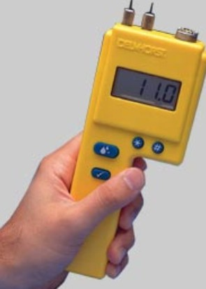
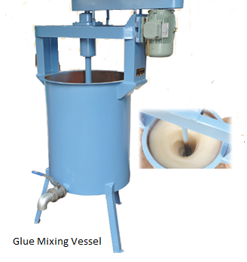
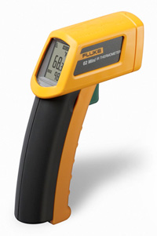
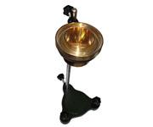
Amylodex Pvt.Ltd 19 Mar 2016 at RCBMA Jodhpur Bhaskar BV Reddy

Slide 12

Thank You
Amylodex Pvt.Ltd. (Formerly Stardex)
bhaskar@amylodex.com
Tele: 040 – 23060334 Fax: 040 - 23061638
Mob: 9866114029
www.amylodex.com
Delhi Excise Depo
Badarpu Border
New Delhi
Mr.S.P. Mishra
09999721580
delhi@amylodex.com
Kolkata Excise Depo
Tentulkuli Village
Howrah- WB
Mr.Aziz
08017468003
Kolkata@amylodex.com
Salem Excise Depo
Nethimedu
Salem-TN
Mr.Rajavadivel
09043283923
salem@amylodex.com
Hyderabad Sales office
Kukatpally
Hyderabad- TG
Mr.Muralikrishna
09642704003
sales@amylodex.com
Amylodex Pvt.Ltd 19 Mar 2016 at RCBMA Jodhpur Bhaskar BV Reddy

Slide 13
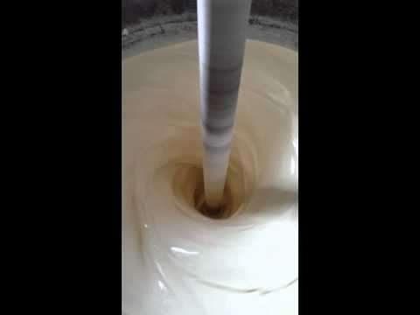
Glue Mixing

